Slide 1

Revision 1- Page Rank Algorithm

Slide 2

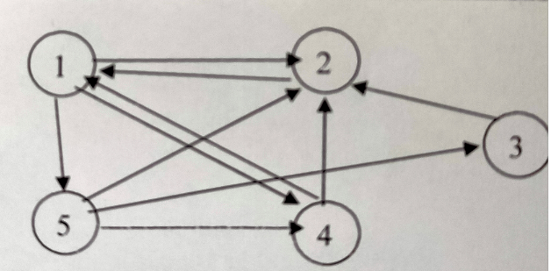
Revision 1
Given Graph

Slide 3
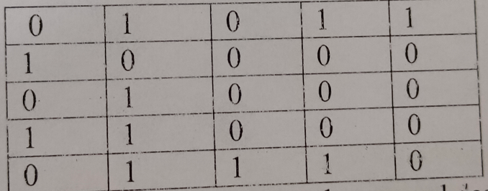
Revision 1
Step 1: Obtaining the Adjacency Matrix

Slide 4
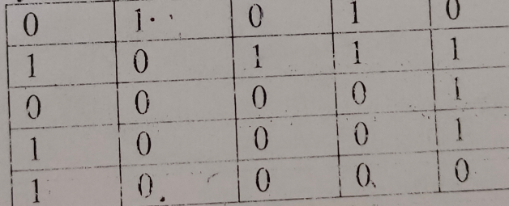
Revision 1
Step 1: Both the ways are correct

Slide 5
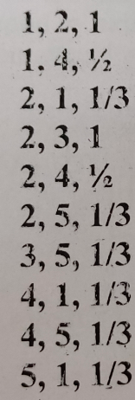
Revision 1
Step 2 : Writing the Sparse representation in the form of CSV

Slide 6
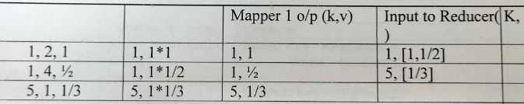
Revision 1
Step 3: Page rank computation for 1st Iteration Mapper 1

Slide 7
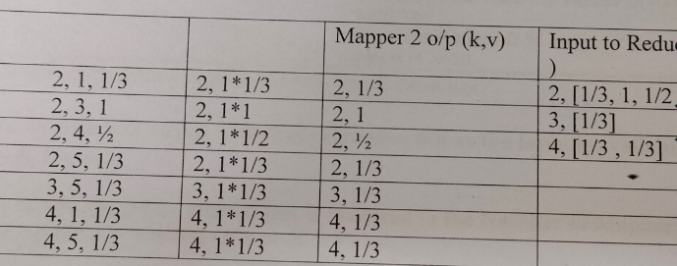
Revision 1
Step 4: Page Rank Computation for Mapper 2

Slide 8
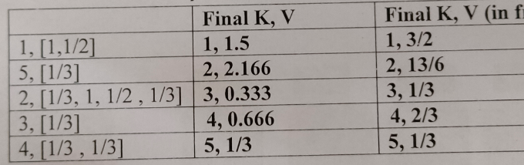
Revision 1
Step 5: Final Reducer Output the resultant vector after 1st iteration

Slide 9
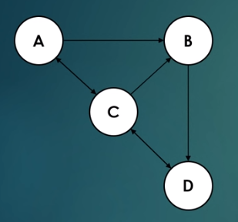
Revision 1
Perform 2 iteration for the given graph

Slide 10
THANK YOU

